Slide 1

RELATIONAL DATABASE SCHEMA
FOR POPCORNPAL MOVIE APP

Slide 2

INTRODUCTION
Task: To design a relational database schema to store information about movies,actors,directors,genres,and user reviews.
A highlight of the key entities and their attributes:
Director: Director_id Director name Director DOB Director nationality
Movie: Movie id Movie name Genre Movie length Rating Production year Director id(FK) Description
Actor: Actor id Actor name Actor nationality Gender Actor’s DOB Awards

Slide 3
INTRODUCTION
A highlight of the key entities and their attributes:
Genre: Genre id(primary key) Genre name
User: User id(primary key) User name User email User password Date joined
Reviews: Review id User id Movie id Rating Comment Review date

Slide 4
INTRODUCTION
A highlight of the associative entities and their attributes:
Movie genre: Movie genre id Genre id Movie id
Cast: Cast id Movie id Actor id
History: History id Movie id User id
Movie review: MR id Movie id Review id

Slide 5


RELATIONSHIPS BETWEEN ENTITIES
Movie & Actor : many-to-many relationship since many actors can be cast in many movies.
Movie & Director : one-to-many relationship since a movie can only have one main director, while a director can oversee more than one movie .
User and Review : one-to-many relationship since a user can write many reviews, but a review can only be written by one user.
User and Movie : many-to-many relationship since multiple users can watch many movies.
Movie and Genre : many-to-many relationship since multiple movies can belong to multiple genres.

Slide 6
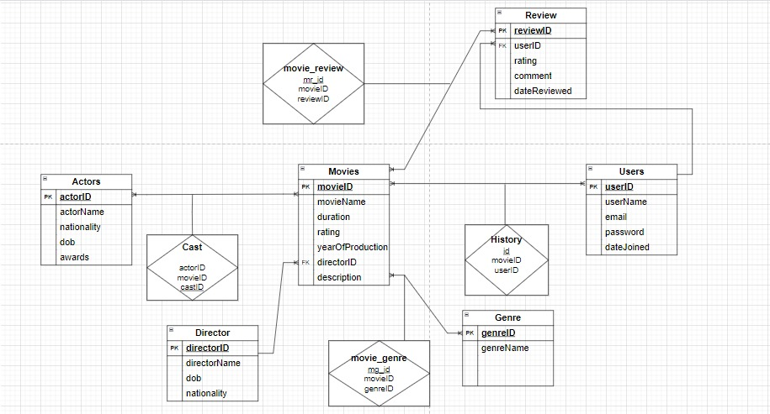
RELATIONSHIPS BETWEEN ENTITIES –ER diagram

Slide 7
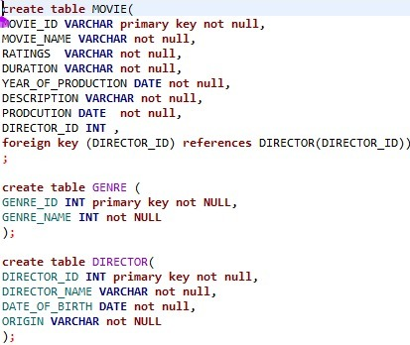
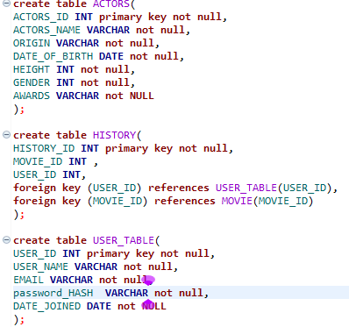
DATA TYPES AND CONSTRAINTS

Slide 8
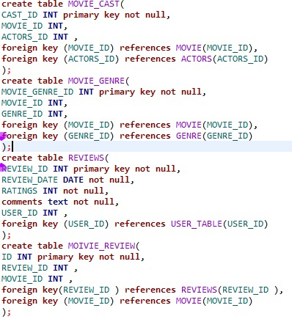

Slide 9
Why we used a relational model
Normalization: Reduces data redundancy, ensuring each piece of data is stored in only one place, thus improving data integrity , storage and retrieval efficiency
Data Integrity: Ensures accuracy and consistency through constraints such as primary keys, foreign keys, and checks.
Flexibility: Supports complex queries, allowing the retrieval of specific data based on various conditions and relationships.
Scalability: Efficiently handles large volumes of data, which facilitates growth and expansion of our movie database.

Slide 10


Thank you!
Design by:
Diana Mugho
Timothy Mbata
Jessica Wanjiru

